Slide 1



Text Summarization
Mentor: Mr. Narendra Kumar
Intern: Mr. Mohan Krishna G R
Group: 4

Slide 2
Introduction
Problem Statement & Planning

Slide 3
Introduction
Problem Statement
Developing an automated text summarization system that can accurately and efficiently condense large bodies of text into concise summaries is essential for enhancing business operations.
This project aims to deploy NLP techniques to create a robust text summarization tool capable of handling various types of documents across different domains.
The system should deliver high-quality summaries that retain the core information and contextual meaning of the original text.

Slide 4
INTENDED PLAN
Background
Research
Model Evaluation
Load & Initialize
Deploy
R&D
Model
Data
Eval mode
Evaluation loop
API
Containerize
CI/CD Pipeline
Data Collection
Model Training
Benchmark
Robust
Multi-objective
EDA
Preprocess
Train mode
Training loop
Performance metrics

Slide 5
Background Research
Literature Review & Findings

Slide 6
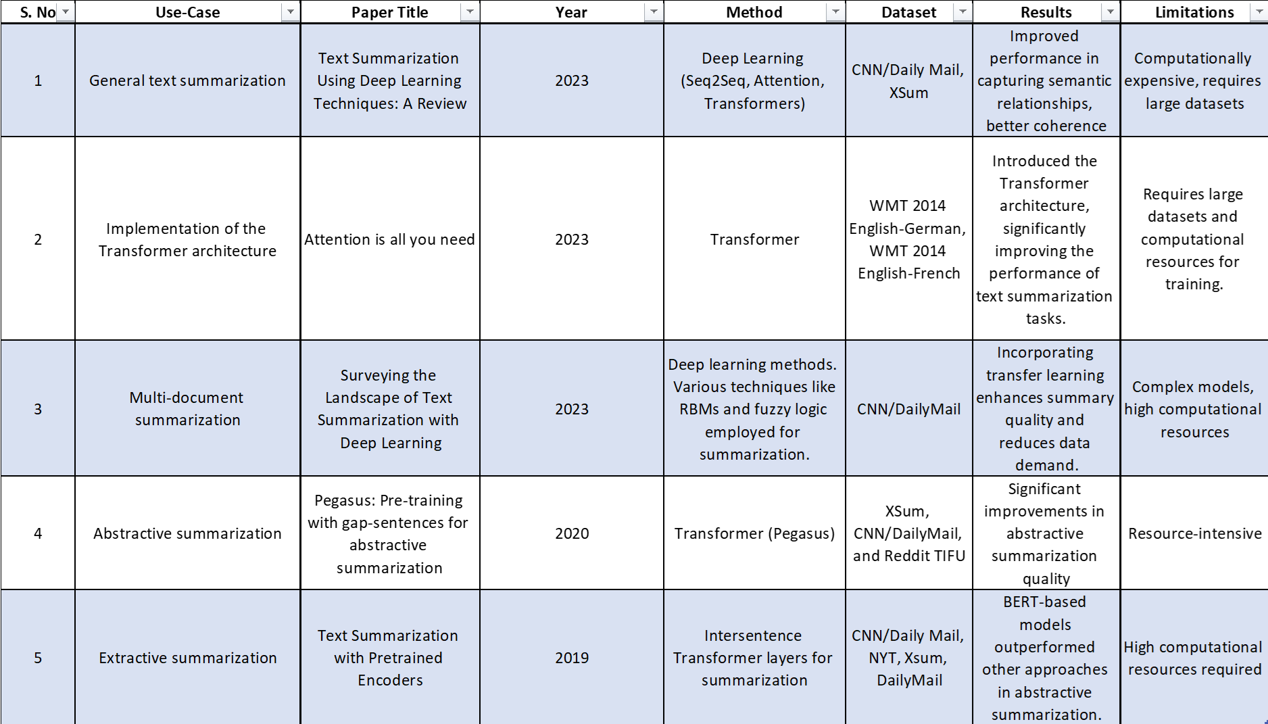
Background Research Literature Review

Slide 7
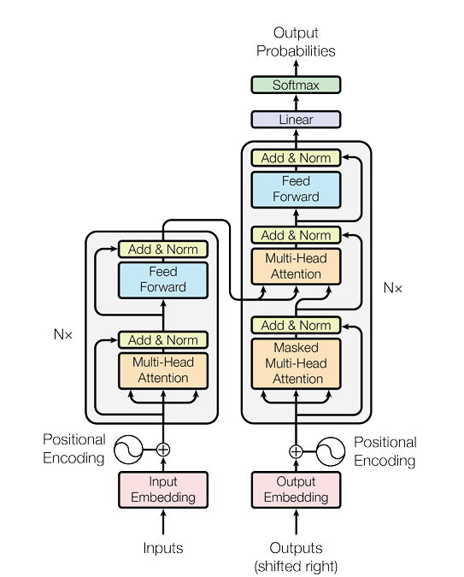
Research
Selected Architecture
Implementation methods:
From Scratch
Build Model
NN
Initialize normalized W&B
Train model with extensive data
Hence,
Computationally Intensive
Sub-Optimal usage of resources
Out-of-scope
Using Pre-trained model
Load Model & its parameters
Re-Train with specific dataset
Evaluate
Hence,
Innovation can be done at intended tasks
Optimal utilization of resources
[2] Fig. :Transformer architecture:

Slide 8
Proposals

Slide 9
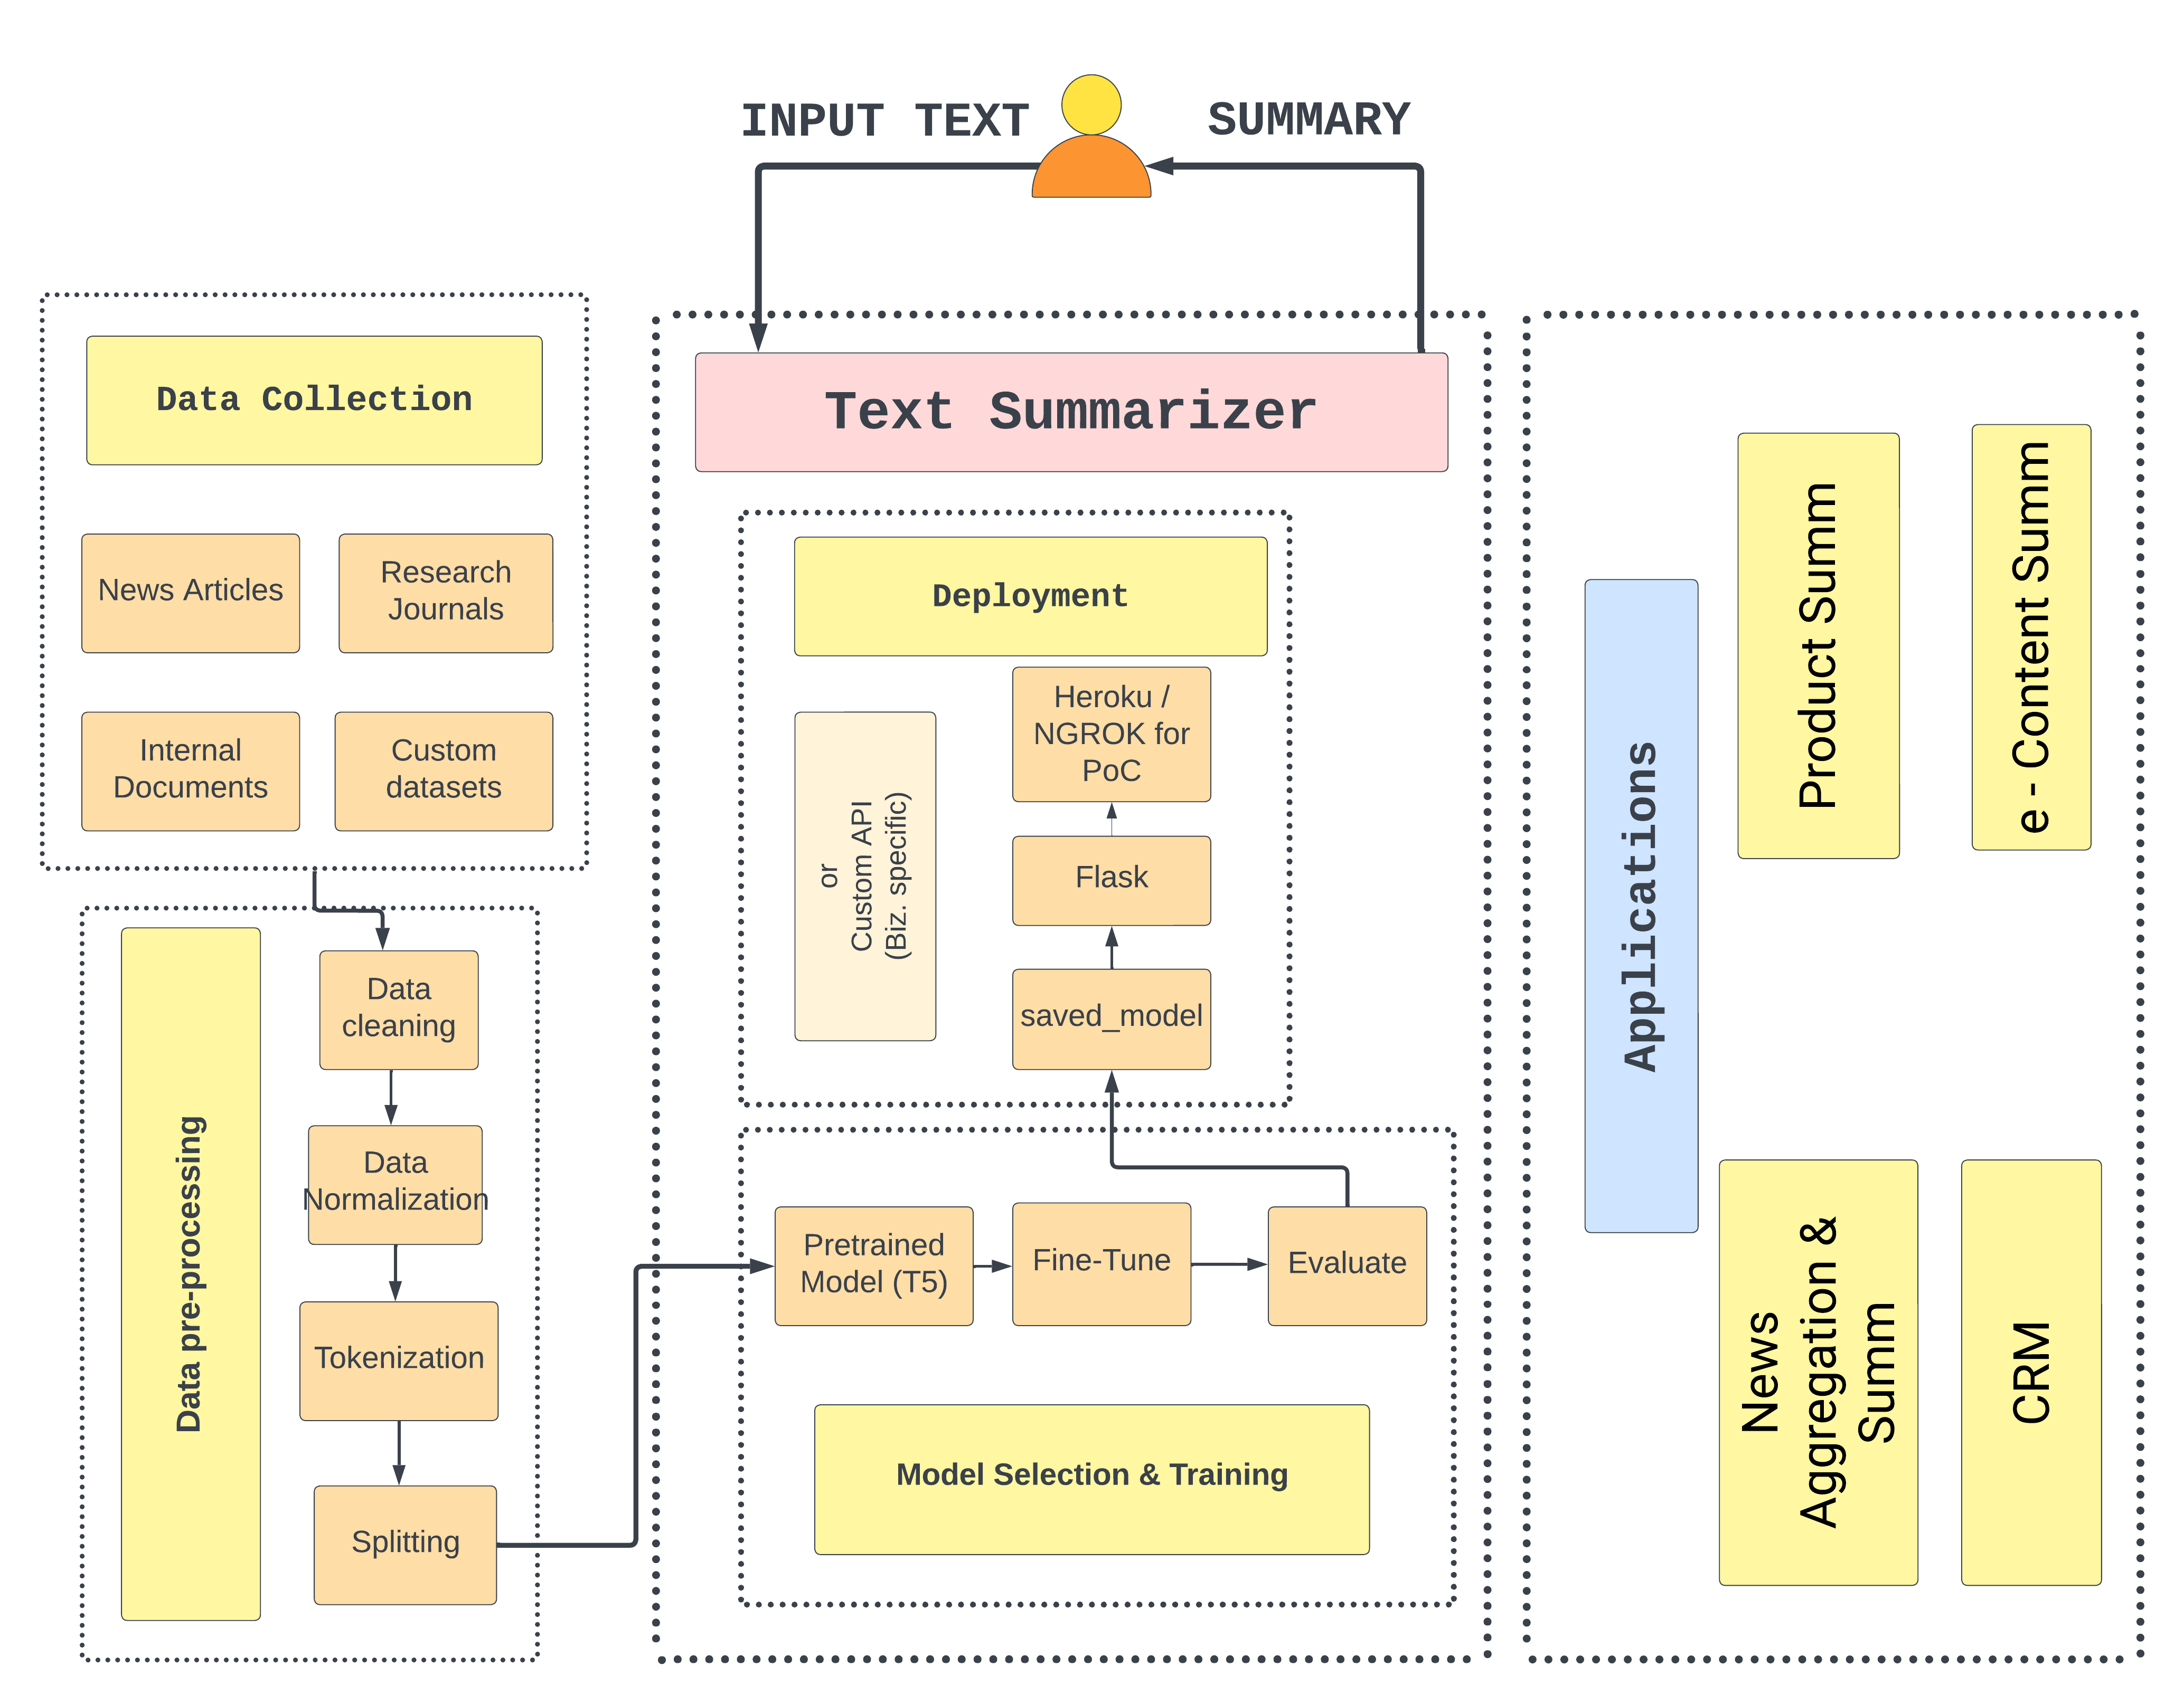
Proposal
Workflow
Fig. : Proposed Workflow for Abstractive Text Summarization

Slide 10
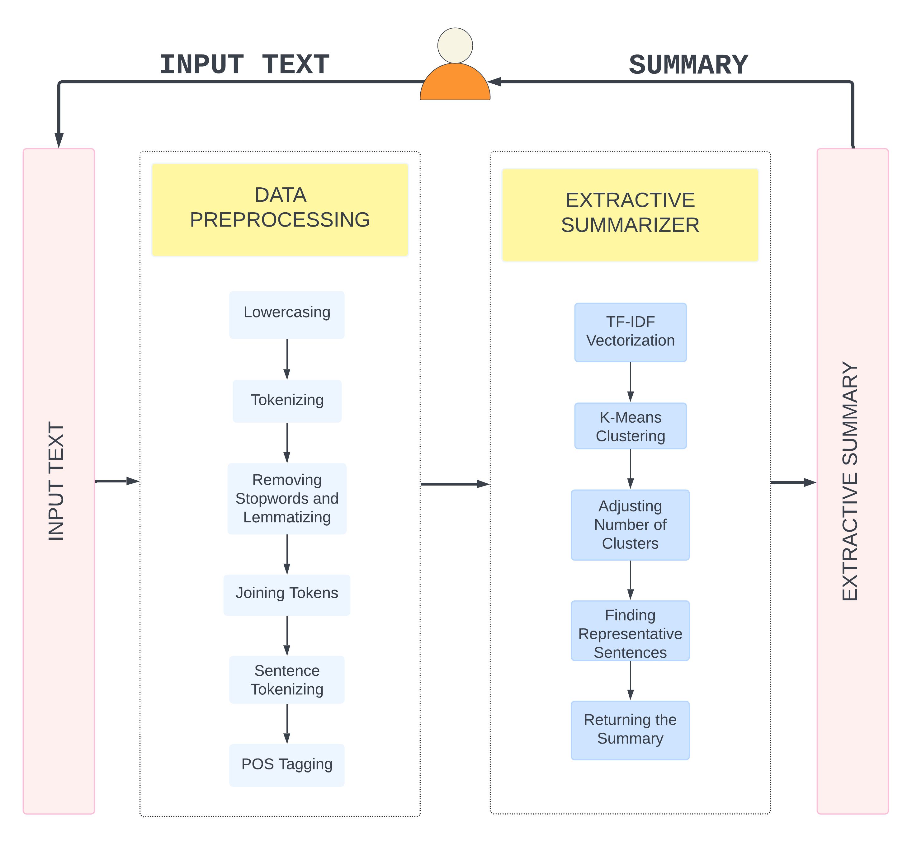
Proposal
Workflow
Fig. : Proposed Workflow for Extractive Text Summarization

Slide 11
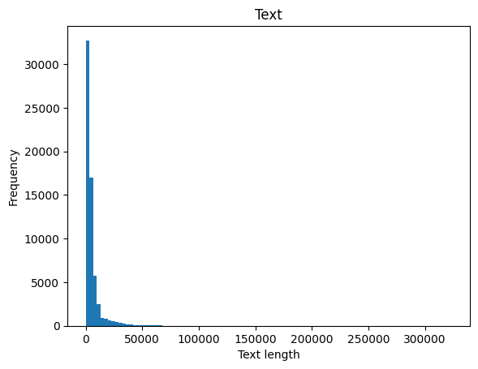
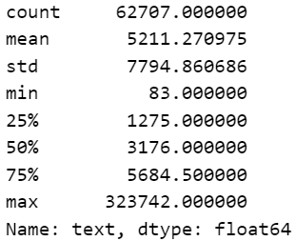
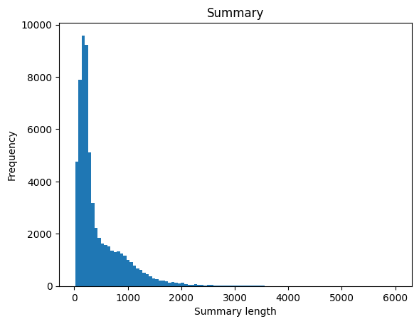
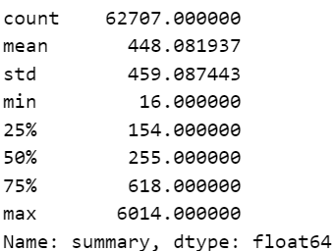
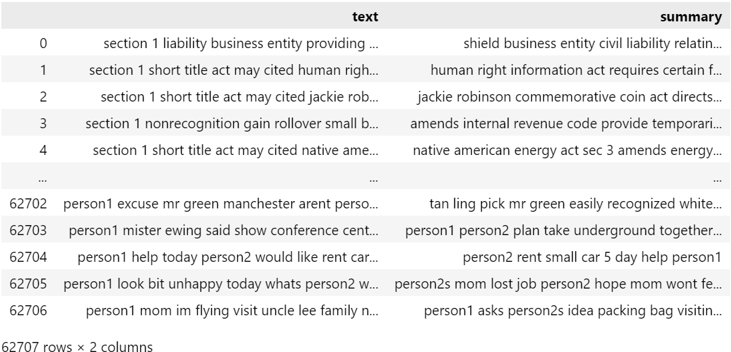
Proposal
Dataset
Merged selective dataset from
CNN, Daily Mail : News,
BillSum: Legal,
ArXiv : Scientific
Dialoguesum : Conversations.
Completed - data preprocessing
Removed
NULL records, punctation, stop-words
Lowercasing, lemmatization.
* In characters.
https://drive.google.com/drive/folders/1yH89iZmARdc-R7QY6pwfE8tbOJI_n9K8?usp=sharing
Infosys_Springboard_Text-Summarization/src/data_preprocessing.ipynb at main · MohanKrishnaGR/Infosys_Springboard_Text-Summarization (github.com)

Slide 12
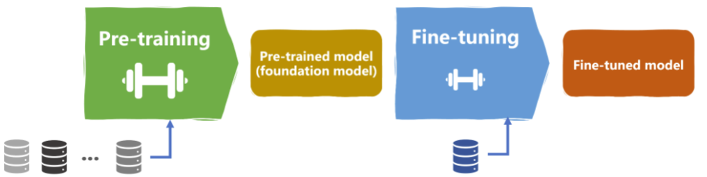
Proposal
Model Training
Fig. : Fine-Tunning Overview
Proposed implementation – Two – 2 Methods
Method 1 – Native PyTorch Method
Method 2 – Trainer Class Method

Slide 13


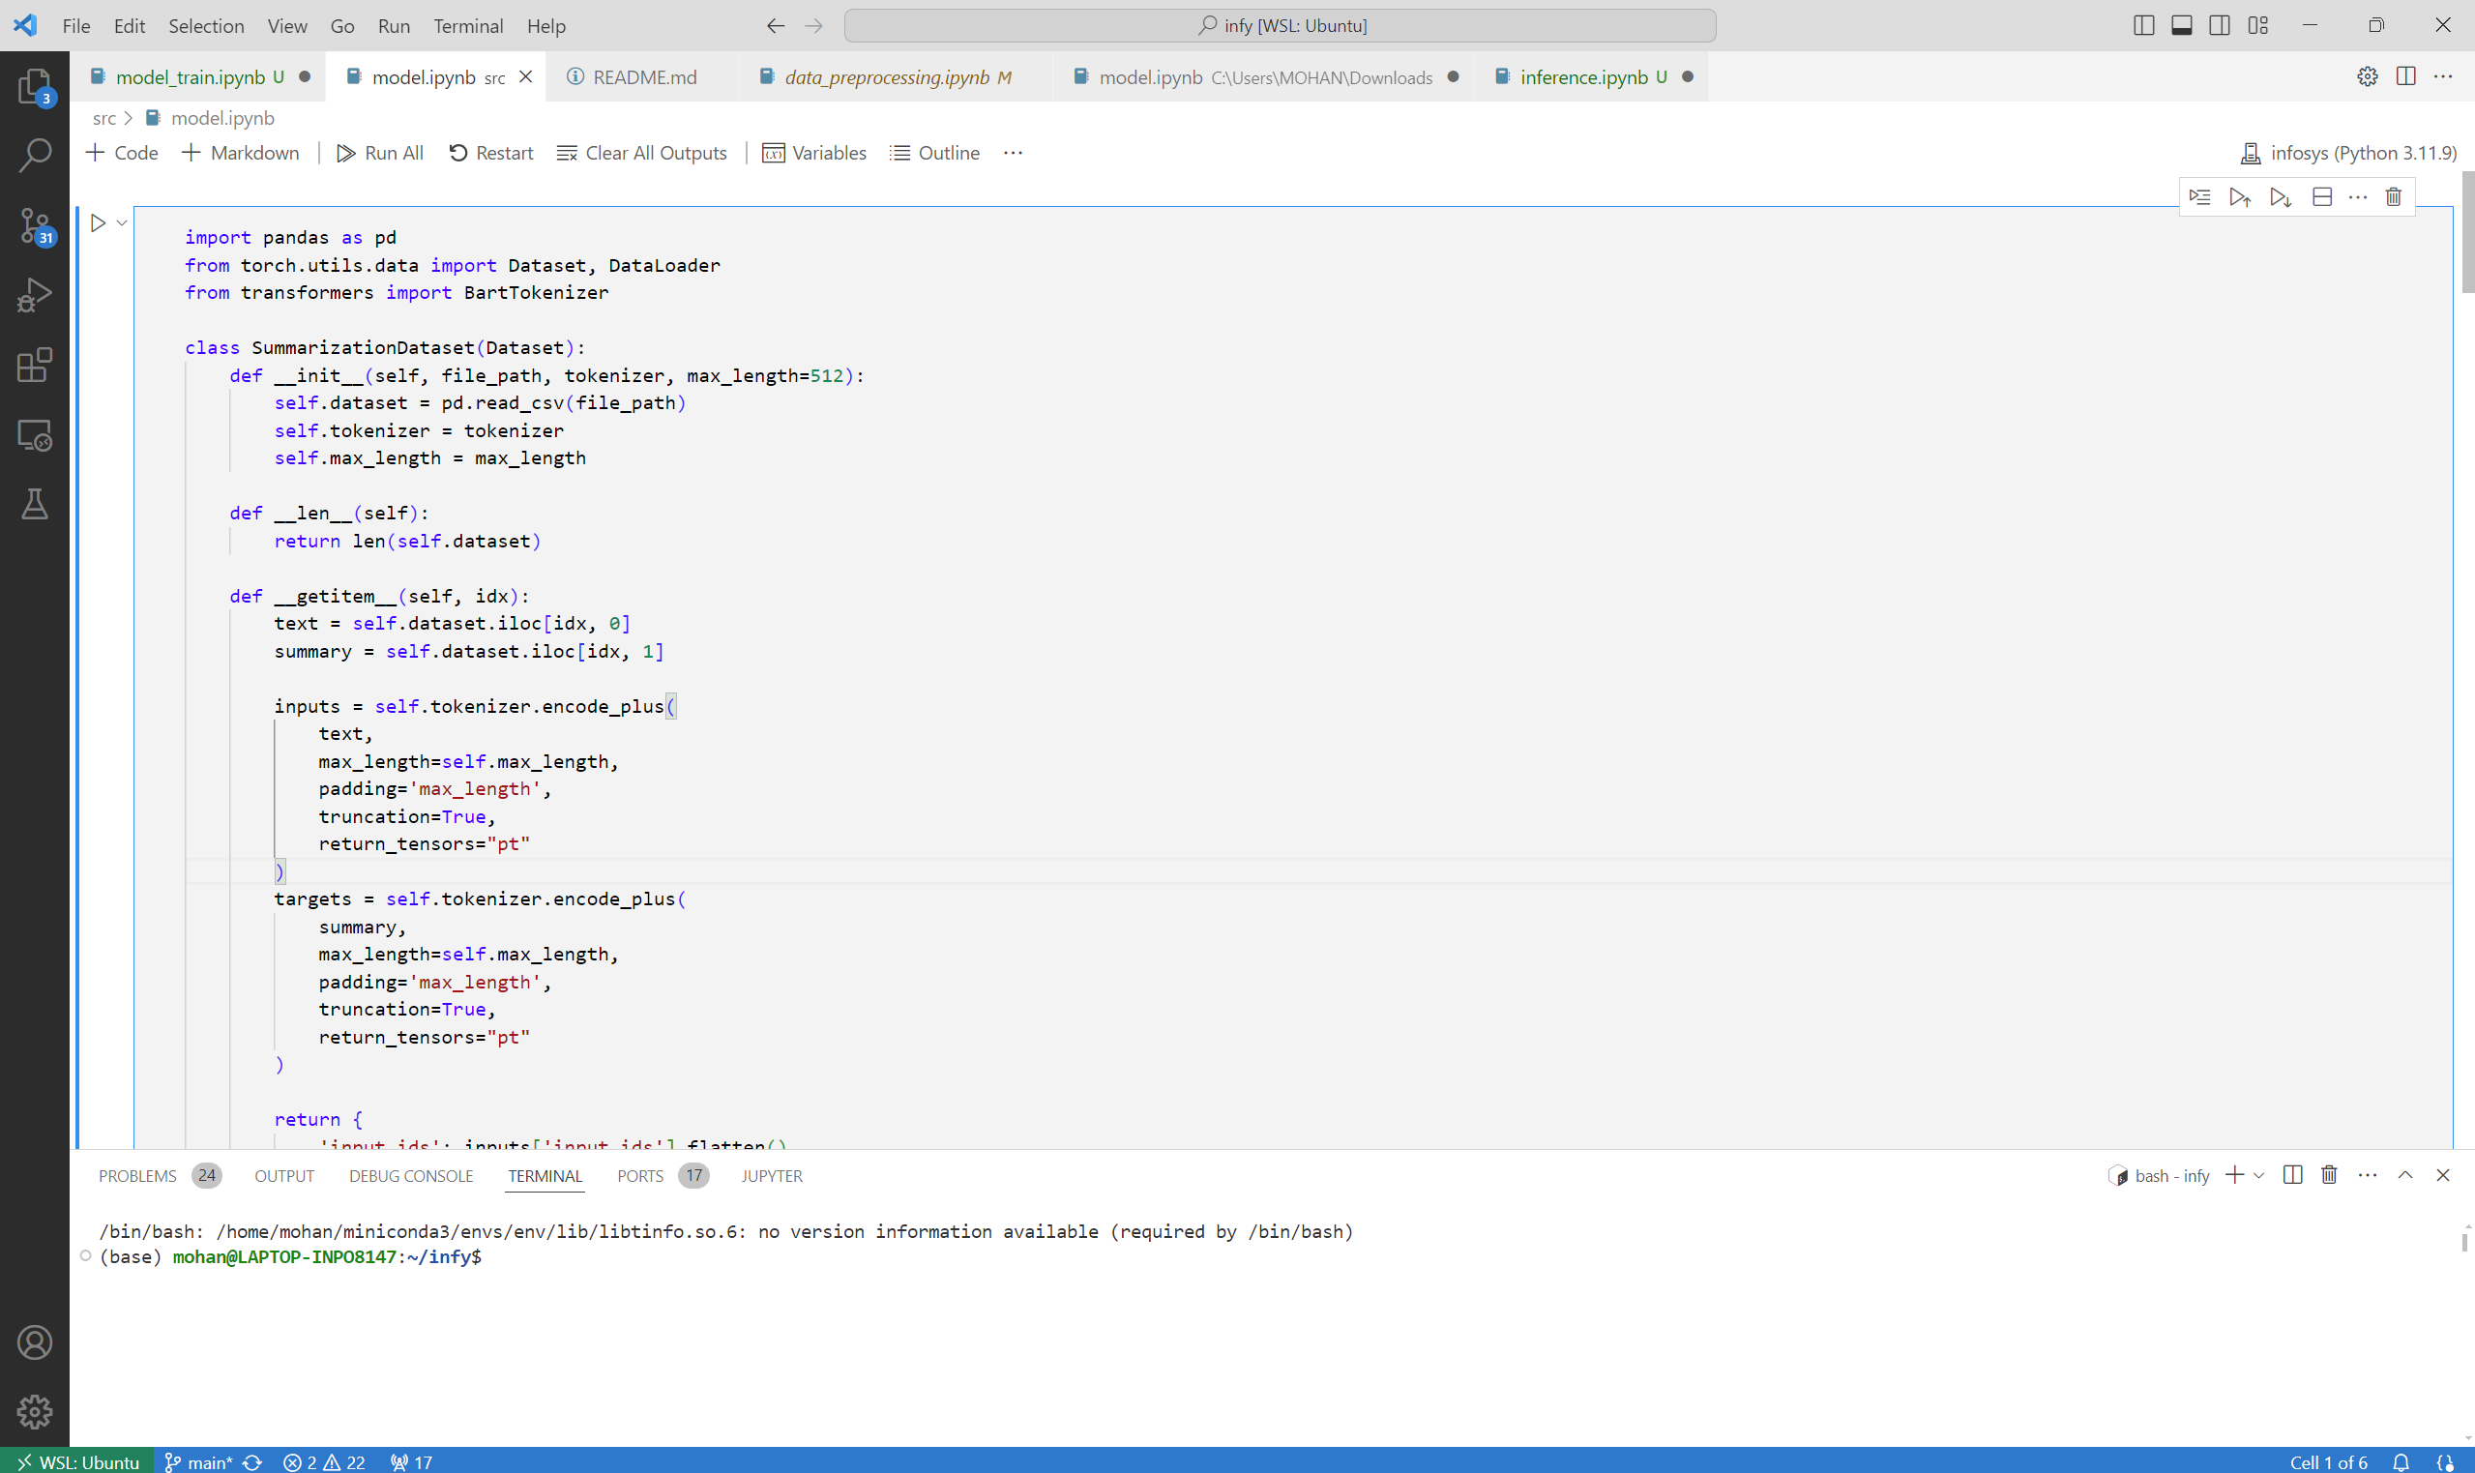
Proposal
Model Training (Method 1)
Load pre-trained transformer
Facebook’s Bart Large
OOP implementation of Dataset
Feature, Target
Tokenize
Padding, Truncate
Convert to Tensor
Pass to: DataLoader – with batch size
Training Loop
Adam optimizer
Forward pass & compute loss
Backward pass
Update params – compute gradient
Update LR
Zero the gradients
Update total loss
Fig. : Screenshot
Only minimal train loss of 1.3280.
But, produced inconsistent results.
Cannot be pushed into production.
Raises the need for optimized training and eval loop for Transformer.
Infosys_Text-Summarization/src/model.ipynb at main · MohanKrishnaGR/Infosys_Text-Summarization (github.com)

Slide 14
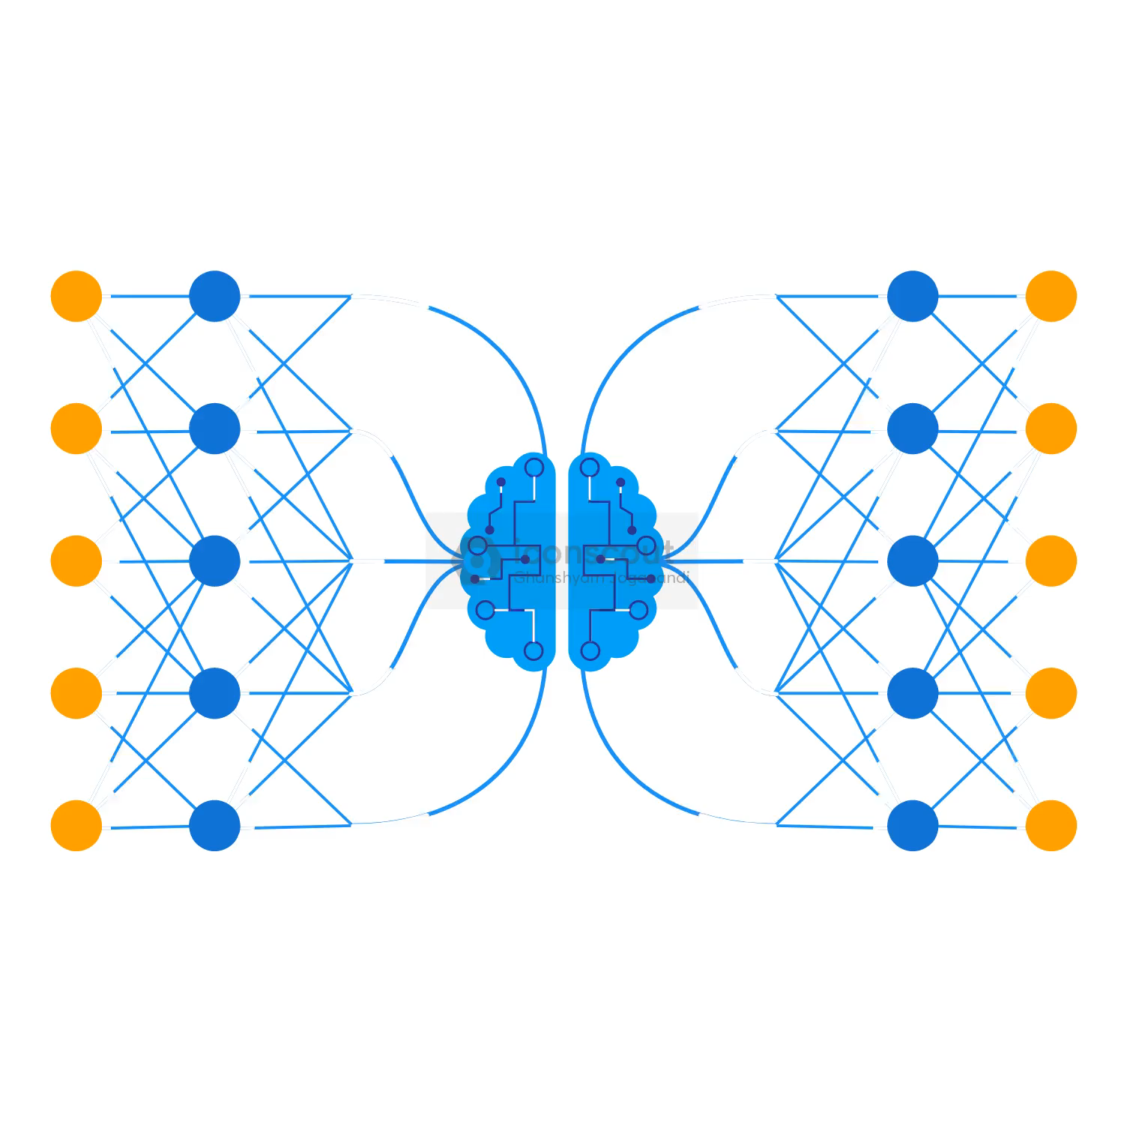
Proposal
Model Training (Method 2)
Trainer Method
Implemented in src/bart.ipynb.
A function was implemented for the dataset, to convert text data into model inputs and targets.
Trainer class from transformer package was utilized for training and evaluation. Tainer is a simple but feature-complete training and eval loop for PyTorch, optimized for transformers.
The model was trained with whole dataset for 10 epochs for 26:24:22 (HH:MM:SS) in 125420 steps.
Training Loss = 17.4700
Considered the performance metrics of the models trained by the forementioned methods. After the due analysis, the model trained using 'Method 2' was selected.
Infosys_Text-Summarization/src/bart.ipynb at main · MohanKrishnaGR/Infosys_Text-Summarization (github.com)
https://drive.google.com/drive/folders/1tNdLI67UTc5es6VB_dml8b5gkRUWzupI?usp=drive_link

Slide 15
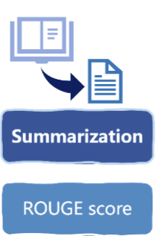
Proposal
Model Validation
Performance metrics – ROUGE (Recall-Oriented Understudy for Gisting Evaluation)
Overlap between generated summary and reference summary.
Best suited : evaluating ‘Text Summarization’ tasks.
Other options : BLEU.
ROUGE-N: Measures the overlap of n-grams (contiguous sequences of n items) between the candidate summary and the reference summaries.
ROUGE-1:
Overlap of unigrams (single words).
ROUGE-2:
Overlap of bigrams (two-word sequences).
ROUGE-L:
Measures the longest common subsequence (LCS) between the candidate and reference summaries.
ROUGE-LSUM
(LCS Summary) - variant of the ROUGE-L metric, specifically designed to evaluate the quality of summaries.
Aimed to: implement custom evaluation function, using ROUGE based on model’s inference.
Infosys_Text-Summarization/src/evaluation.ipynb at main · MohanKrishnaGR/Infosys_Text-Summarization (github.com)
Infosys_Text-Summarization/src/bart.ipynb at main · MohanKrishnaGR/Infosys_Text-Summarization (github.com)

Slide 16
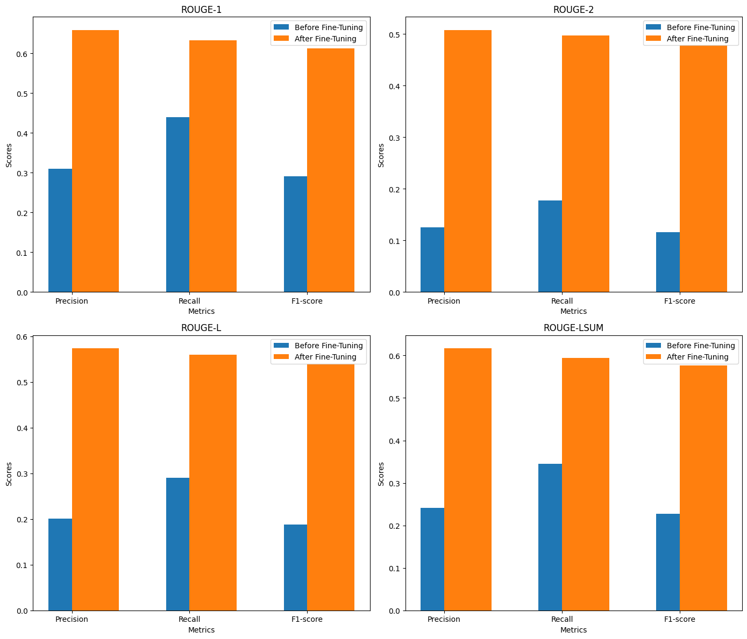
Proposal
Comparative Analysis
Analysis of the transformer’s performance metrics before and after Fine-Tuning.
The transformer model shows significant improvements across all ROUGE metrics after fine-tuning.
The most substantial gains observed in ROUGE-2 scores. (F1-score=61.32)
This indicates that the fine-tuning process has notably enhanced the model's ability to generate more accurate and relevant summaries.
The model is now more proficient at generating summaries that are precise, comprehensive, and contextually accurate.
Will act as a powerful tool for a variety of Business applications that require efficient and effective text summarization.
Infosys_Text-Summarization/src/compare.ipynb at main · MohanKrishnaGR/Infosys_Text-Summarization (github.com)

Slide 17

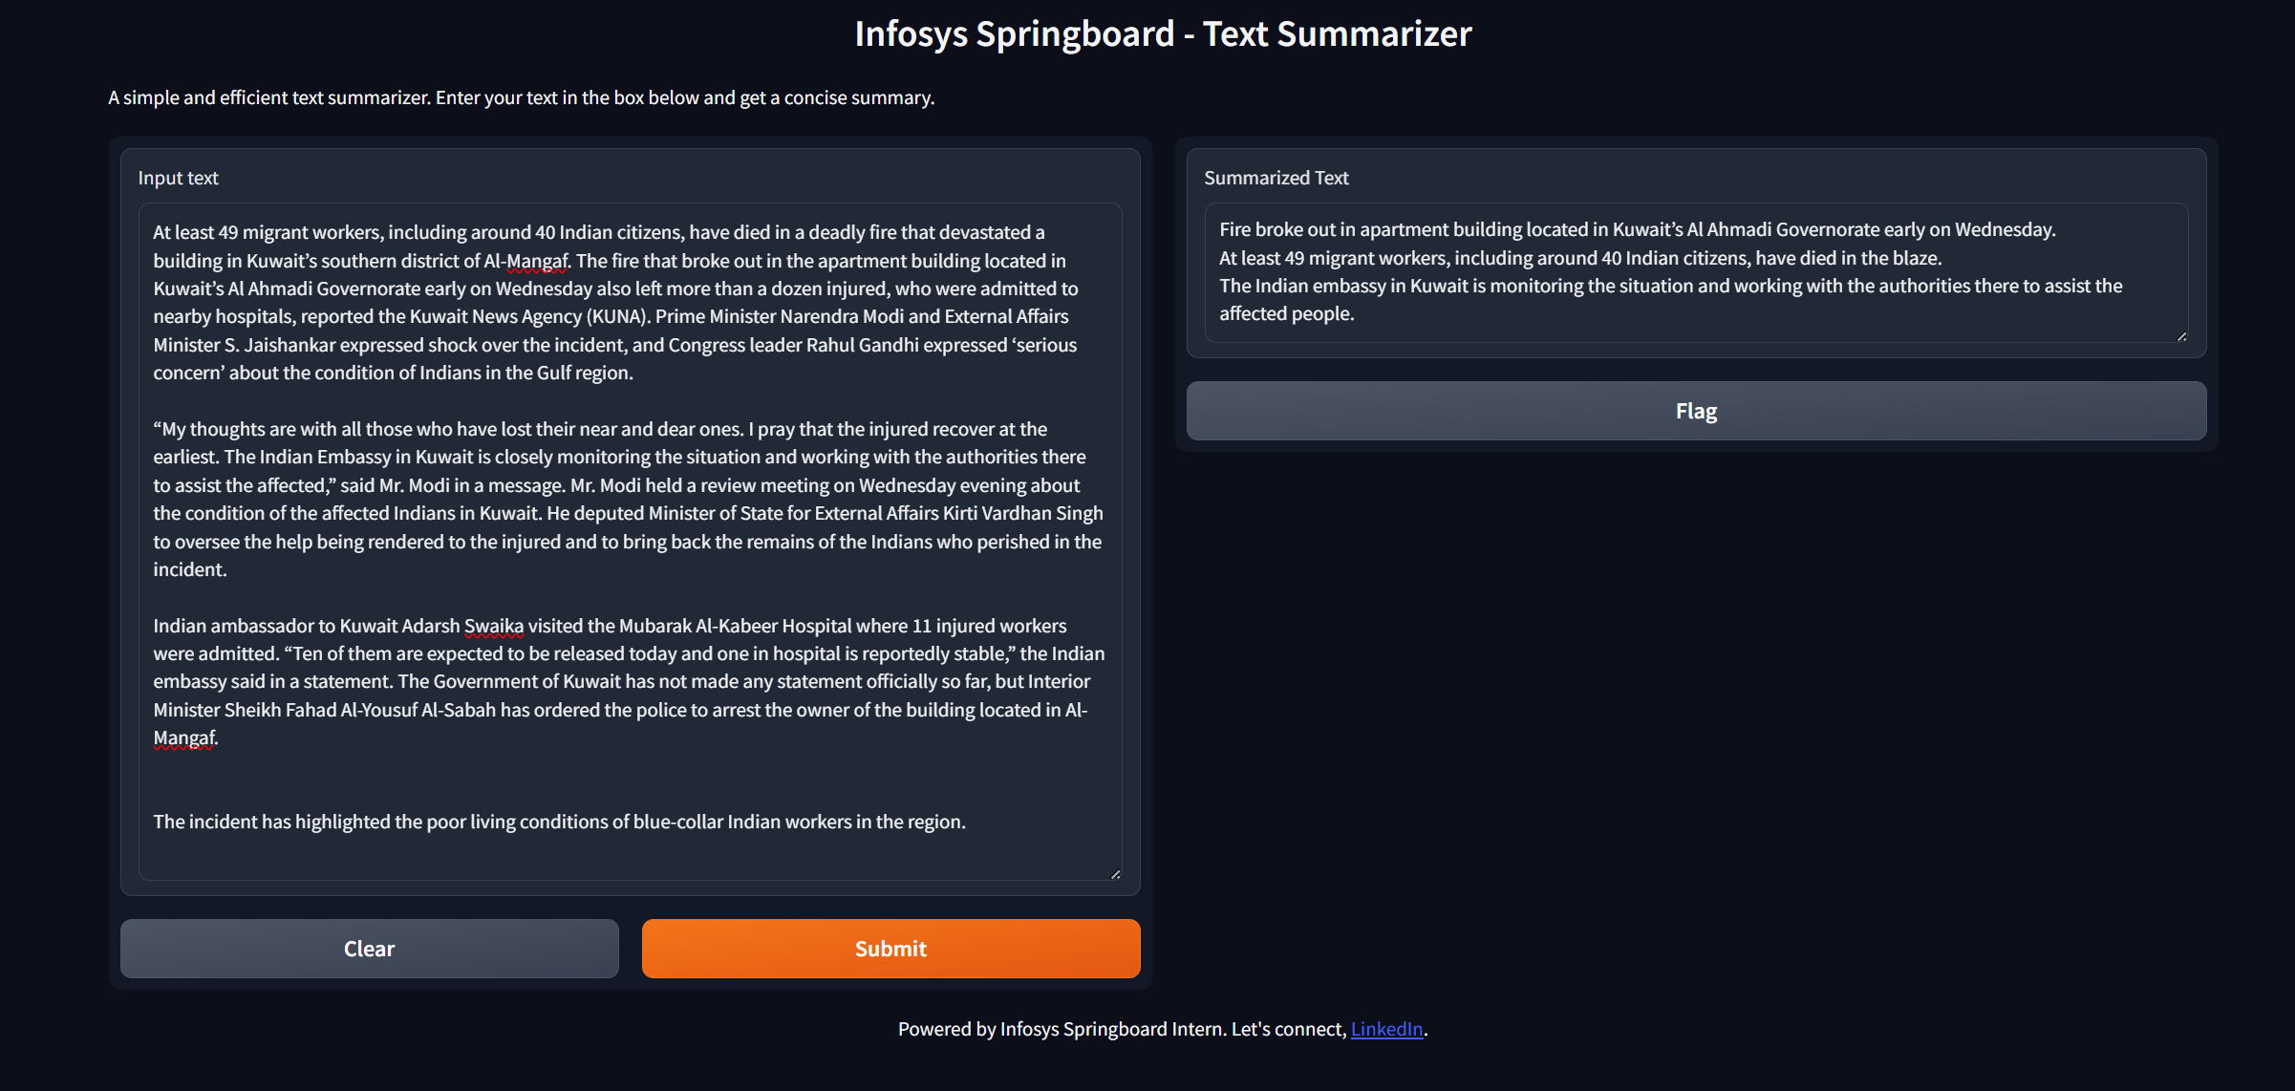
Proposal
Testing
Simple interface for the Deep Learning model, developed using Gradio.
Gradio is an open-source Python package that allows us to quickly build a demo - web-application for the trained models.
Enables us to test and even deploy the trained model.
Infosys_Text-Summarization/src/interface.ipynb at main · MohanKrishnaGR/Infosys_Text-Summarization (github.com)

Slide 18
Proposal
Extractive Text Summarization
Rather than choosing computationally intensive deep-learning models, utilizing a rule based approach will result in optimal solution. Utilized a new-and-novel approach of combining the matrix obtained from TF-IDF and KMeans Clustering methodology.
It is the expanded topic modeling specifically to be applied to multiple lower-level specialized entities (i.e., groups) embedded in a single document. It operates at the individual document and cluster level.
The sentence closest to the centroid (based on Euclidean distance) is selected as the representative sentence for that cluster.
Implementation: Preprocess text, extract features using TF-IDF, and summarize by selecting representative sentences.
Source code for implentation & evaluation: src/Extractive_Summarization.ipynb
ROUGE1 (F-Measure) = 24.71
Fig. : Proposed Workflow for Extractive Text Summarization
Infosys_Text-Summarization/src/Extractive_Summarization.ipynb at main · MohanKrishnaGR/Infosys_Text-Summarization (github.com)

Slide 19





Proposal
Deployment
Infosys_Text-Summarization/src/Extractive_Summarization.ipynb at main · MohanKrishnaGR/Infosys_Text-Summarization (github.com)

Slide 20


Proposal
Deployment
Implemented extractor modules for text extraction from URL, PDF, docx.
Defined the API endpoints. (FastAPI)
Accepts: Text, URL, Files (PDF, docx)
Returns:
Abstractive & Extractive Summary
Utilized ‘jQuery’ for a dynamic webpage.
Containerized the entire application along with the deep-learning models.
Built the image & Pushed into docker hub.
Drawback = Less computation for free-tier plan (t2.micro)
Deployed the docker image using Azure Container Instance
Integrated with GitHub actions – CI/CD pipeline
Advantage = 4 CPU cores for Free Trail

Slide 21
Results

Slide 22
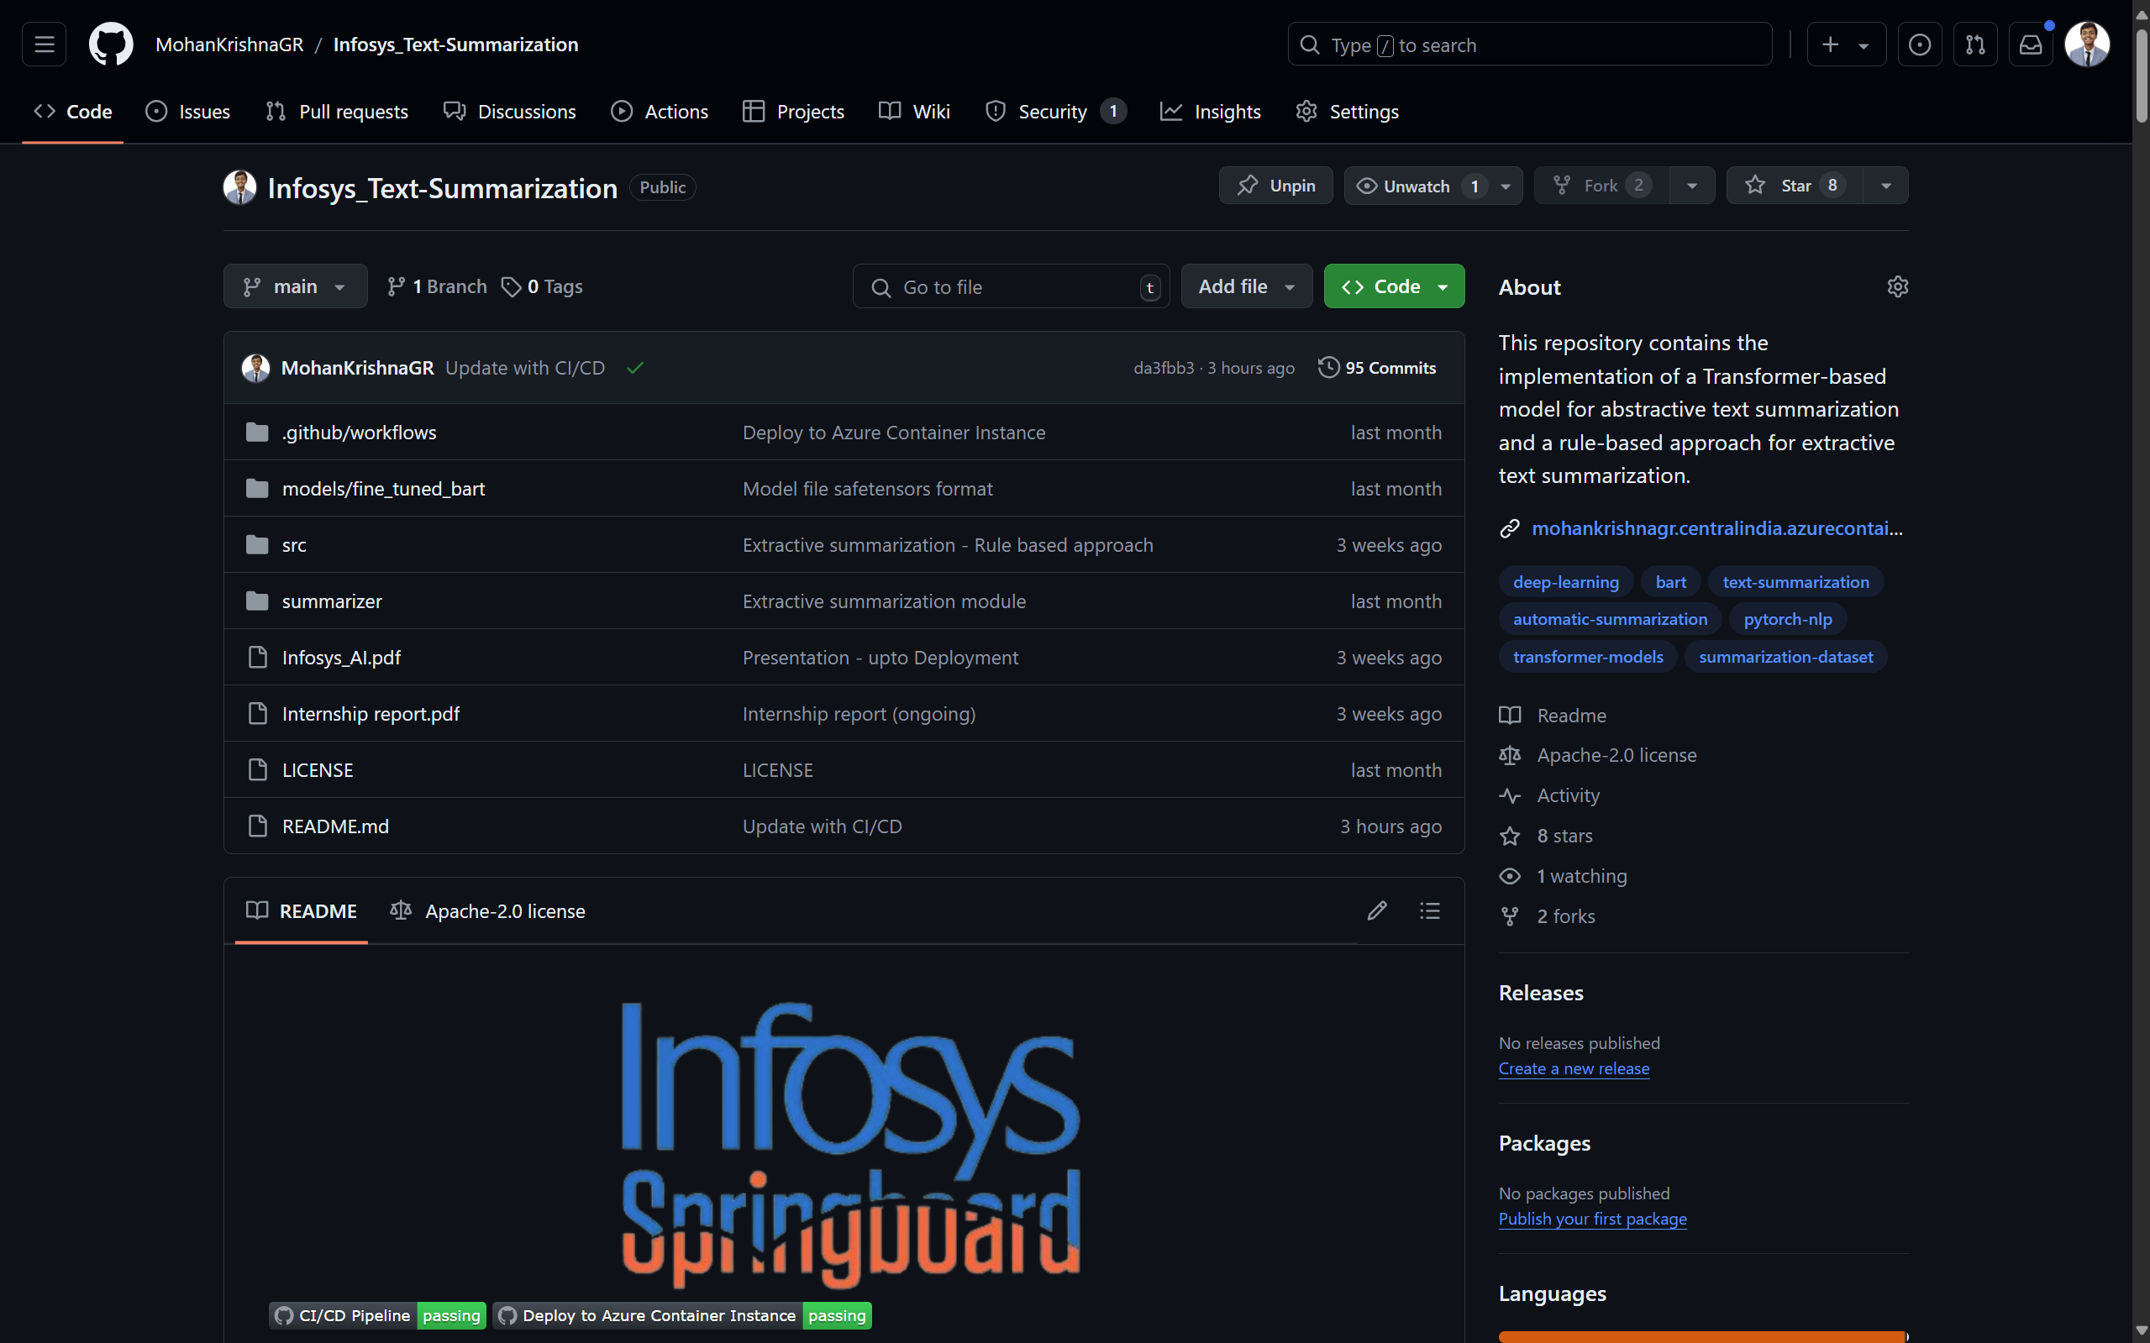
Results
GitHub Repository
Fig. : Screenshot of the GitHub repository.
MohanKrishnaGR/Infosys_Text-Summarization

Slide 23
Result
Deployment - Ref. Links
mohankrishnagr/infosys_text-summarization - Docker Image | Docker Hub
Text-Summarizer
http://54.168.82.95/
Text-Summarizer
http://mohankrishnagr.centralindia.azurecontainer.io:8000/
http://20.219.203.134:8000/

Slide 24

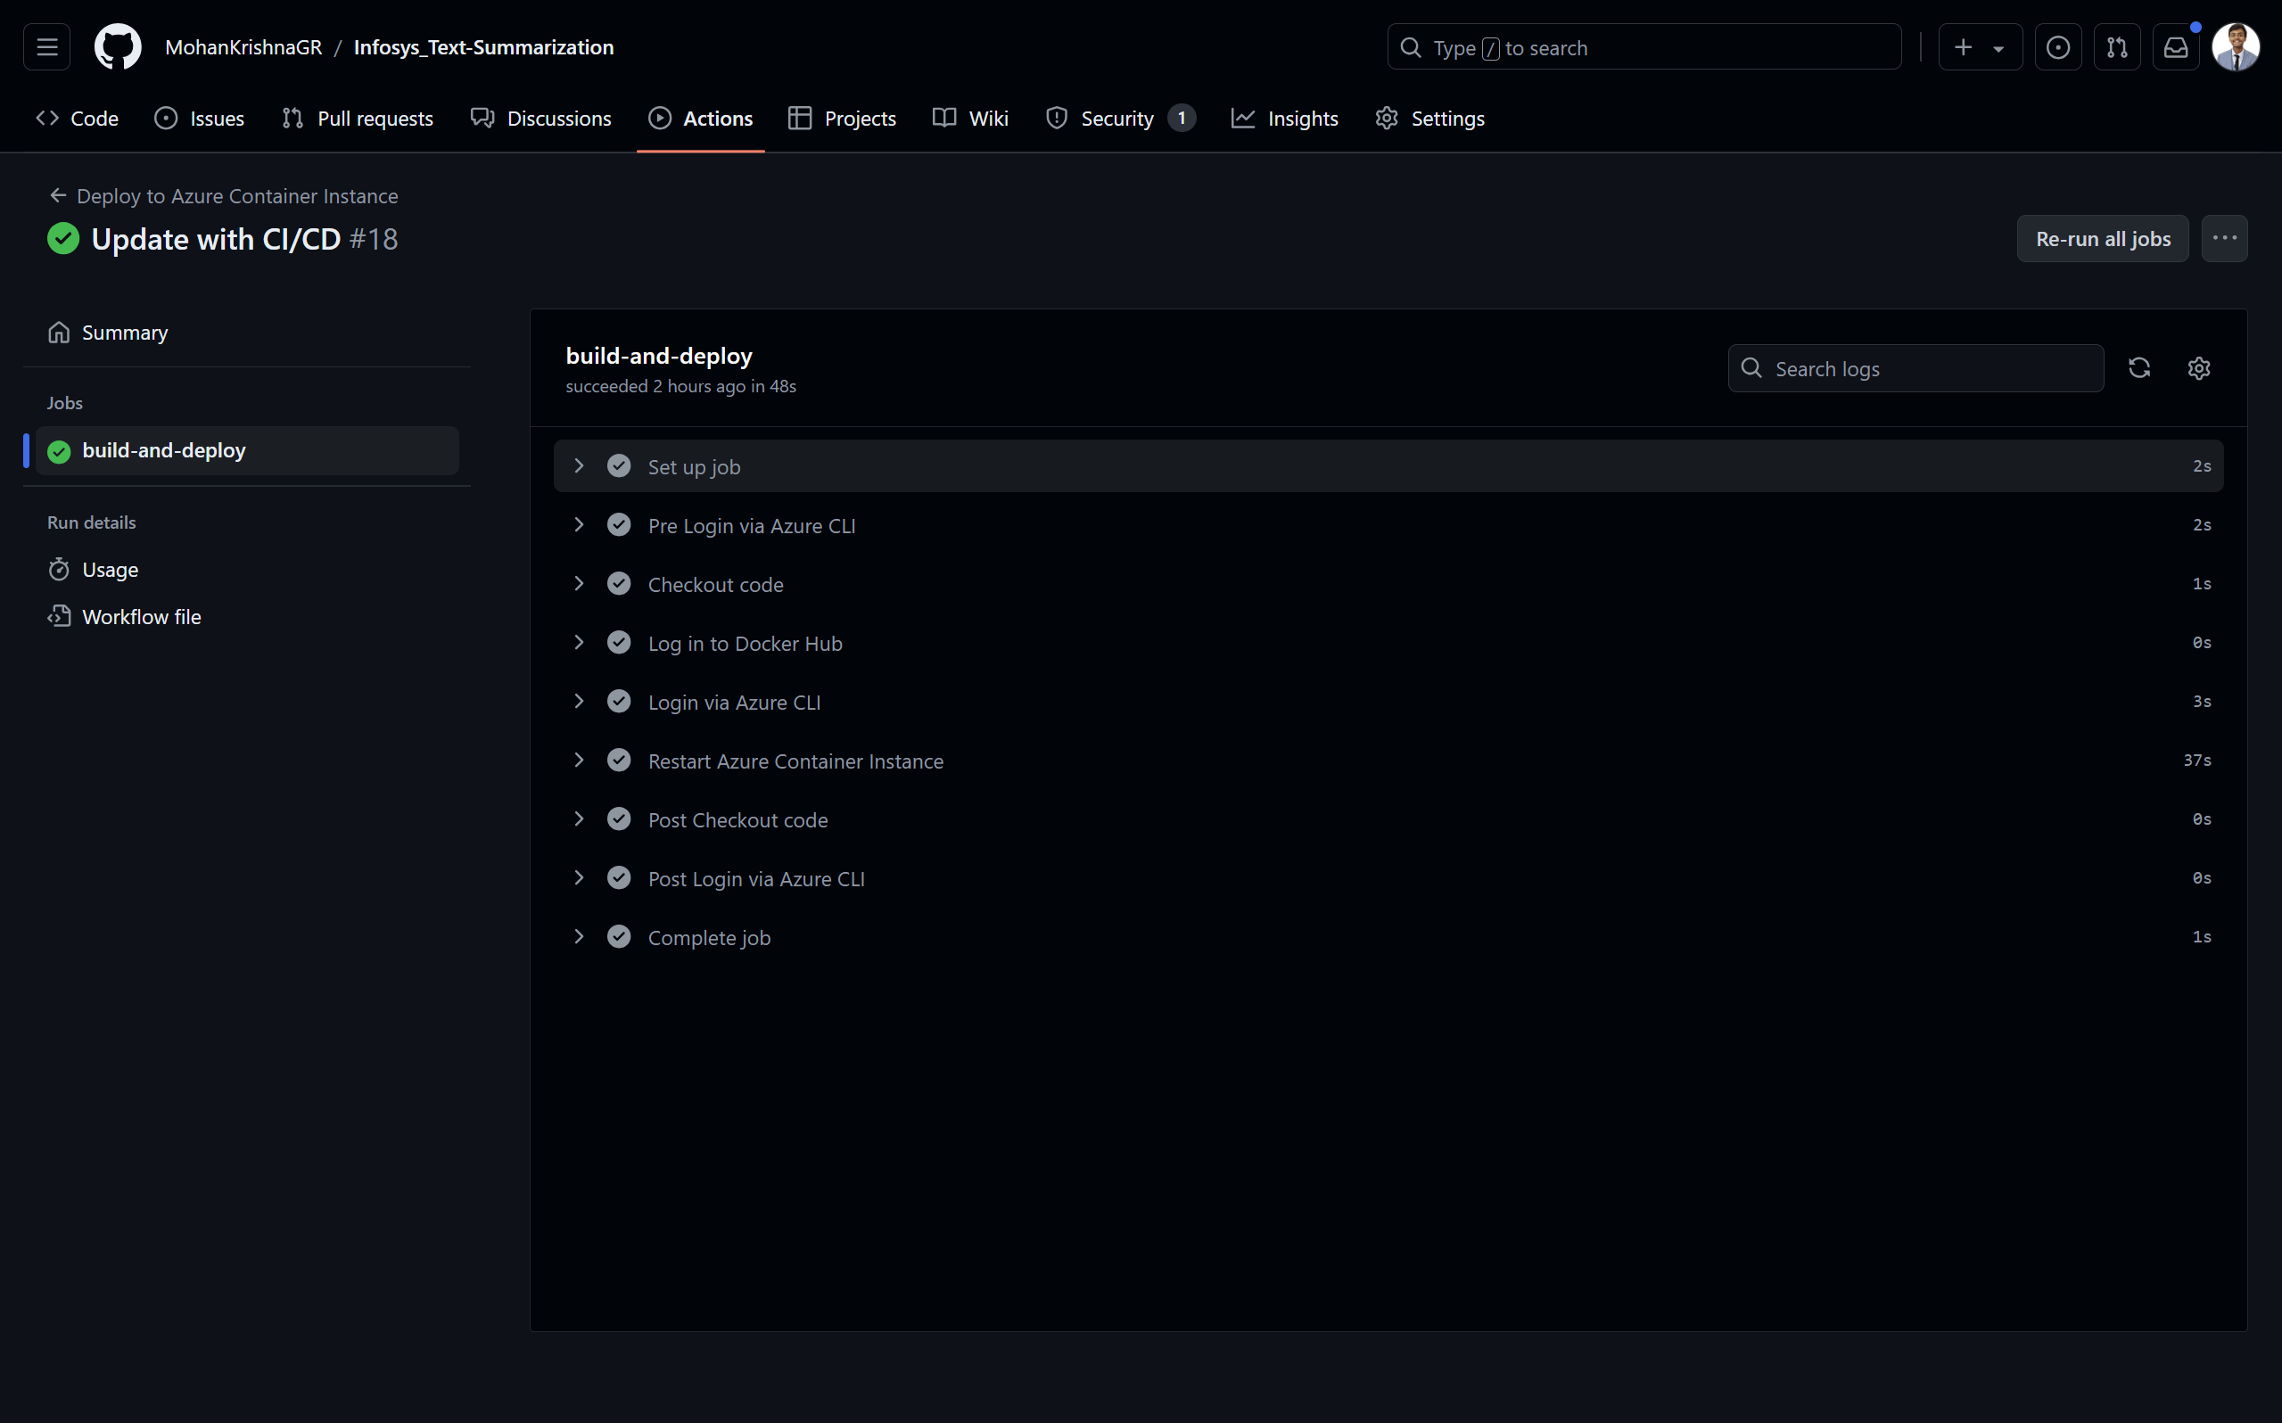
Results
CI/CD pipeline
Fig. : Screenshot of the CI/CD pipeline.

Slide 25
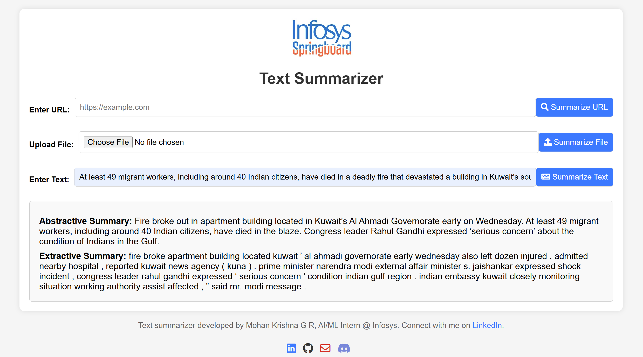
Results
Deployed Application
Fig. : Screenshot of the Deployed application – Text input.

Slide 26
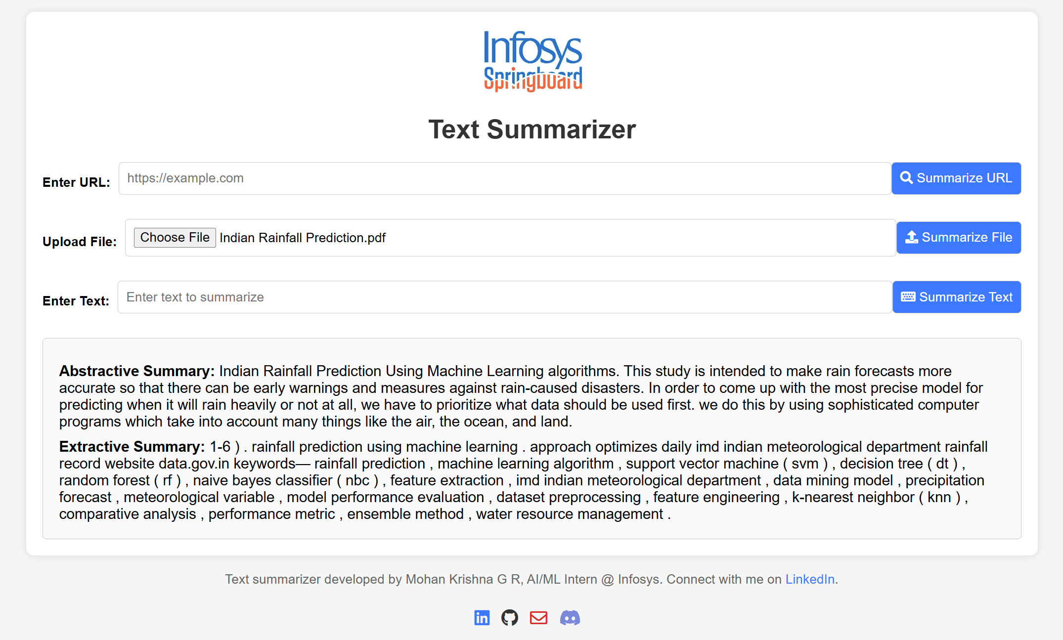
Results
Deployed Application
Fig. : Screenshot of the Deployed application – PDF input.

Slide 27
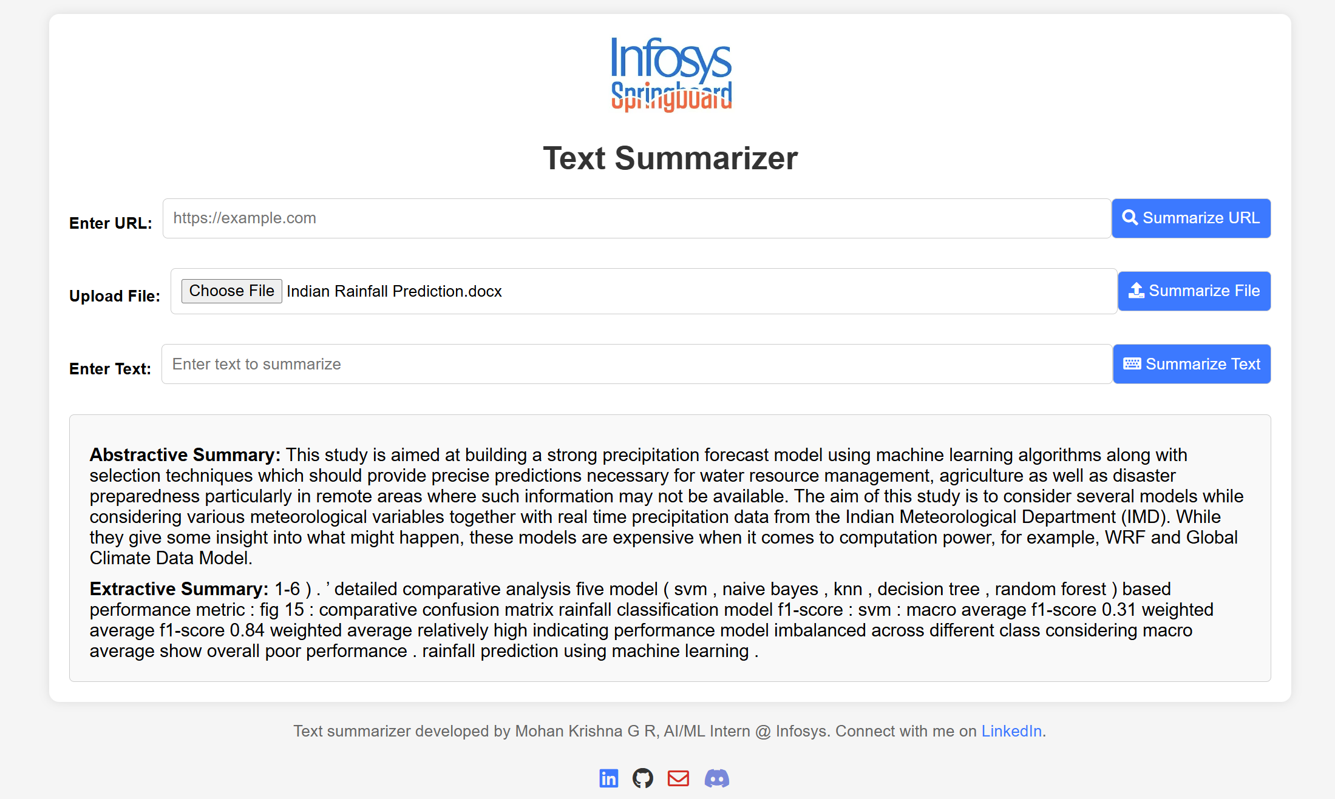
Results
Deployed Application
Fig. : Screenshot of the Deployed application – DOCX input.

Slide 28
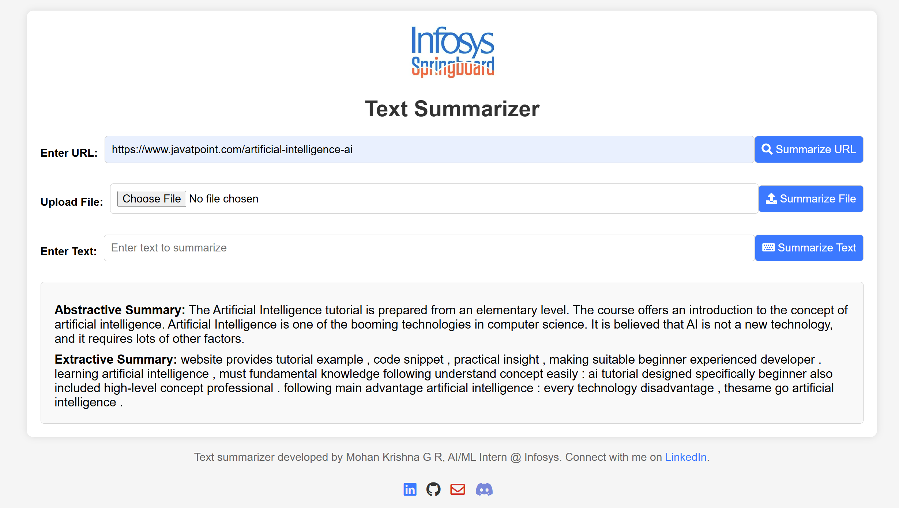
Results
Deployed Application
Fig. : Screenshot of the Deployed application – URL input.

Slide 29

T H A N K Y O U !!!

